Slide 1
Life Sciences Data Governance Strategy case study Presenter: An Dai
Notes:
This presentation was automatically generated by PowerPoint Copilot based on content found in this document: https://pmicloud-my.sharepoint.com/personal/adai_pmintl_net/Documents/Microsoft%20Copilot%20%E8%81%8A%E5%A4%A9%E6%96%87%E4%BB%B6/Life%20Sciences%20Data%20Governance%20Strategy_%20Why-What-How%20Presentation.pdf AI-generated content may be incorrect.

Slide 2
Agenda
WHY: The Strategic Imperative of data governance
WHAT: Governance Strategy & Framework
HOW: Implementation Strategy (Demo)
WHO: Key Stakeholders & Engagement (Demo)
LESSONS LEARNED
Notes:
Agenda * Introduction * WHY: The Strategic Imperative * Current State Challenges * Strategic Value Opportunity * Key Business Value Metrics by Function * Key Governance Framework Elements * Advanced Governance Capabilities * Function-Specific Governance Focus * HOW: Implementation Strategy * Phase 1: Assessment & Discovery * Phase 2: Framework Development * Phased Implementation Approach * WHO: Key Stakeholders & Engagement * Understanding Governance vs. Management * Function-Specific Implementation Strategy * Governance Structure * LESSONS LEARNED & CONCLUSION * Critical Success Factors * Risk and Value-Based Approach Benefits * Anticipated Questions

Slide 3
Current State Challenges
Lack of Tangible Evidence of Value
Senior management requires clear evidence of data value
Varying Levels of Data Documentation
Different sub-functions have inconsistent documentation practices
Inconsistent Data Ownership Models
Some models are full-time, while others are additional duties
Compliance Mandates
Corporate Data & Analytics team mandates require adherence
Tailored implementation per business needs
Notes:
The current state of data management faces several challenges, including varying levels of data documentation, inconsistent data ownership models, lack of tangible evidence of value for senior management, and compliance mandates from the Corporate Data & Analytics team. Original Content: Current State Challenges Varying levels of data documentation across sub-functions Inconsistent data ownership models (some full-time, some additional duty) Lack of tangible evidence of value for senior management Corporate Data & Analytics team mandates requiring compliance

Slide 4
WHY: Strategic Value Opportunity
Transform data from a compliance burden into a strategic asset that drives business performance across all Life Sciences sub-functions.
Strategy values
Clinical Trials
Standardized metadata reduces study setup time by 20-30%
Poor data quality costs an estimated $5-$10K per amendment
Pre-clinical
Smooth data transfer reduces delays in clinical development by 1-3 months
Improves experiment reproducibility by 40-60%
Regulatory
increases first-cycle approval rates by 15-25%
reduces submission compilation time by 30%
RWE
Increased data reusability and Reduces duplicate data acquisition costs by 15-25%
improve analytical model performance
Enhance decision making through trusted and accessible data
Regulatory compliance and reduced exposure
Accelerate innovation through reusable data assets
Increase operational efficiency across subfunctions
AI readiness

Slide 5
WHAT: Governance Strategy & Framework Policy to implementation
FAIR data for life science
Value driven & compliance
Centralized metadata (aka data catalogue) (accelerated by AI)
Components
Data Stewardship Model (clear R&R enabled by AI assistant)
Operationalize FAIR through 5 step lifecycle management
Discover (F) – Define (R) – Standardize (I) – Protect(A) – Govern & Optimize

Slide 6

Function-Specific Governance Focus - no-one fit for all approach
Value driven & compliance
Clinical Trials
Protocol data integrity
Site data quality
eCRF standardization
Submission readiness
Pre-clinical
Experimental reproducibility
Method standardization
Sample traceability
Regulatory
Submission accuracy
Real-World Evidence
Data source credibility, bias control, analytical reproducibility

Slide 7
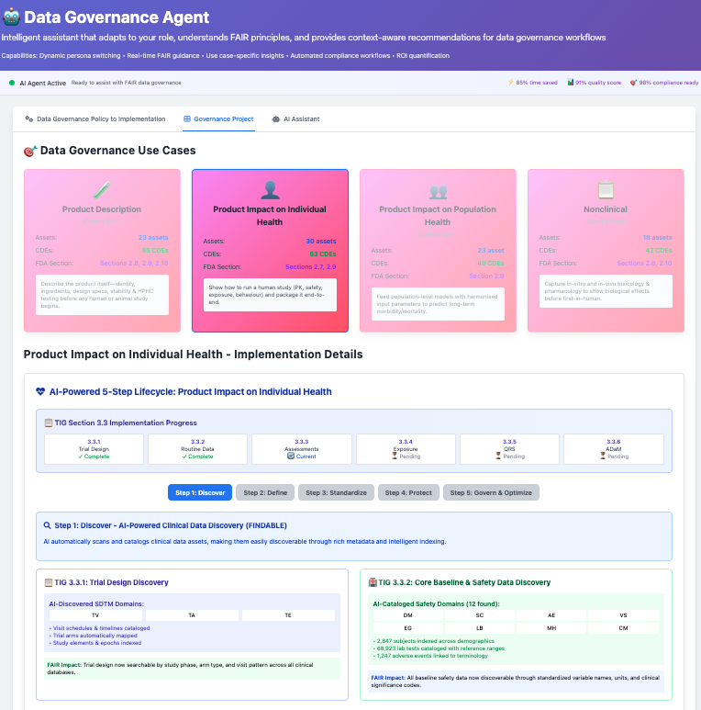
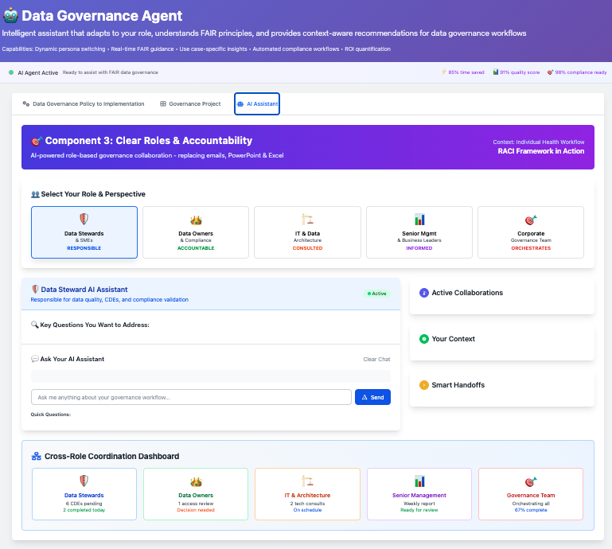
demo – how & who

Slide 8
LESSONS LEARNED Data governance for Life Sciences must be value-driven, AI-ready, and easy to adopt.
Data governance exists to serve business needs—like regulatory compliance, process efficiency, and AI-readiness—not as an end in itself.
Executive sponsorship comes from demonstrating real business value, not just talking about governance.
Clear roles and responsibilities must be supported by tools that make governance easy, not add more work (they should be part of the tool design)
Governance success must be measured by its impact on business outcomes, like risk reduction and improved AI readiness.
Ultimately, governance must unlock data context for AI and decision-making—making data ready, relevant, and trusted (data catalogue becomes even more important)

